Slide 1
Introduction to Multiplication
3rd grade
Miss Stiverson

Slide 2
Definition of Multplication
Multiplication is repeated addition.
Multiplication is fast addition.

Slide 3
What is repeated addition?
For example: If you have 3 people and each person has 4 balls, this means that you would have to add 4 together 3 times.
4 + 4 + 4 = 12 This picture
shows how to draw
this repeating
addition problem.
There are 12 balls or 12 crosses total
++
++
++
++
++
++

Slide 4
Examples of repeated addition
4 4 8
4 + 4 + 4
+ 4 OR 8 12
12
With this problem of repeated addition you needed to add 4 together 3 times to get the correct answer.

Slide 5
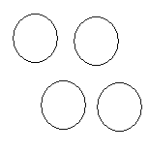
Pictures
If we look at 4 x 3, I would draw 4 circles and put 3 crosses in each circle
4 x 3 = 12
The next page is going to show you a real world example of drawing a picture for a multiplication problem
+
++
+
++
+
++
+
++

Slide 6
Multiplicatoin
This is a picture or drawing example of the problem 3 x 4=12
There are 3 guys, each guy has 4 balls. There are 12 balls total.
Each group must have the same amount of balls.

Slide 7
Wow
Did you notice…
3 x 4 = 12 and
4 x 3 = 12
They have the same answers
It’s the same problem just in a different order. Think of 3 + 4=7 it has the same answer as 4 + 3=7.

Slide 8
Using repeated addition for 3 x 4=12
4 4 8
4 + 4 + 4
+ 4 OR 8 12
12
With this problem of repeated addition you needed to add 4 together 3 times to get the correct answer.

Slide 9
Practice
You have a multiplication problem:
3 x 5 = ?
Which of the following pictures would show it the best? To answer this problem you need to click on the best answer.
O O O O
O O O O
O O O O
O O O O O
O O O O O
O O O O O
O O O
O O O
O O O
If you need to go back to review repeated addition use this arrow to do so otherwise answer the question:

Slide 10
Good Try!
Try using repeated addition
3 x 5=?
try adding 3 together 5 times

Slide 11
Great Job!
O O O O O
O O O O O
O O O O O
This was the correct answer
The problem is 3 x 5 = ?
There are 3 groups
1 group of yellow
1 group of green
1 group of blue
Each group has the same number of circles; They each have 5 circles.

Slide 12
What is the correct answer?
What is the correct answer to the problem?
3 x 5 = ?
20 18 15

Slide 13
Great Work!
Excellent Job
Using repeated addition
5 + 5 + 5= 15 or
3 x 5=15

Slide 14
Great Try
Try to use repeated addition to solve this problem.
Keep in mind you need 3 groups of 5
Try Again!

Slide 15
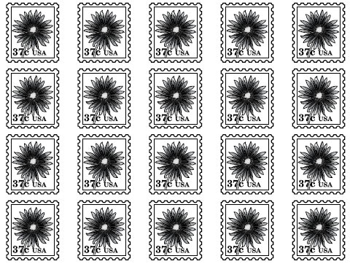
Repeating Addition
Tony has 20 stamps
What is one way
to find the total
number of stamps?
Notes:
This problem is from the Meap Released items that I found at http://www.gobles.org/ElementarySchool/ReleasedMEAPItems/tabid/132/Default.aspx (I used the second option 3rd grade Math)

Slide 16
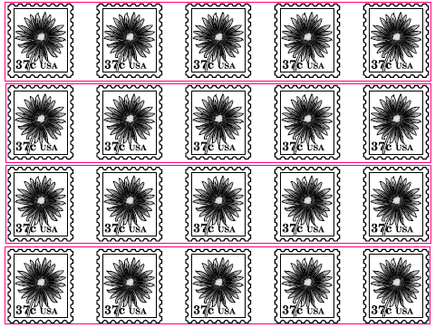
Repeating Addition
This problem
puts the stamps
into groups.
The answer would
be
5+5+5+5+5 5+5+5+5 4+4+4+4

Slide 17
Multiplication
Another way to
show the same
answer to this
problem would be
to use
multiplication
4 x 5=20

Slide 18
Practice
Solve this number sentence
5 x 2 =?
Which picture shows the answer correctly?
Hint: you need 5 rows with 2 in each column
1 2 3

Slide 19
Excellent Work!
Great Job!
1
2
3
4
5
There are 5 rows or groups
There are 2 squares in each row or group
5 x 2=10

Slide 20
Keep Trying!
It might help for you to solve this problem on paper.
Use repeated addition
5 groups with 2 in each group or
Add 5 together 2 times

Slide 21
Challenge
Now that you have had some practice let’s have you try on your own.
You are going to take a short quiz.
Try to do your best!

Slide 22
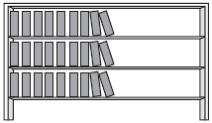
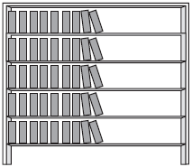
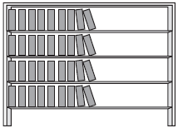
1. Quiz
Which bookshelf has 4 shelves with 9 books on each shelf?
Notes:
This questions comes from Meap 3rd grade Math-Test 15 http://www.linkstolearning.com/quizzes/meap/index0145.htm

Slide 23
Great Work
That was the correct answer!
4 x 9=36
1
2
3
4
There are 4 shelves
There are 9 books on each shelf

Slide 24
Good Try!
Try again!
Keep in mind that you are looking for 4 shelves with 9 books on each shelf.
Think about the library

Slide 25
2. Quiz
James reads 8 pages of a book each day for 4 days. What could James use to find the total number of pages he read during those four days?
8+4 4x8 4+4+4+4
Notes:
This questions comes from Meap 3rd grade Math-Test 15 http://www.linkstolearning.com/quizzes/meap/index0145.htm
The answer for this page is supposed to be 8x4, but I changed the answer so that it followed the rule that I am trying to teach the students, how many groups and how many in each group.

Slide 26
Great Work!
The answer 4 x 8, shows that James read 4 days and read 8 pages each day
4 groups or 4 days of 8 pages each day
4 x 8=32

Slide 27
Try Again!
Don’t give up
Think about this…
how many days did he read and
how many pages did he read in each day
How many days x how many pages each day

Slide 28
3. Quiz
Jenna bought 4 sets of light bulbs. The bulbs come in sets of 4. How many light bulbs did she buy in all?
4x1=4 4x2=8
4x4=16
Notes:
This questions comes from Meap 3rd grade Math-Test 15 http://www.linkstolearning.com/quizzes/meap/index0145.htm
The answers were changed to fit into my lesson.

Slide 29
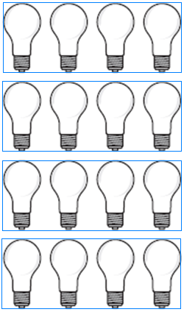
Great Work
Nice Job
Pretend that the
bulbs are grouped
by fours
There are 4 groups
with 4 in each group 4 x 4=16

Slide 30
Sorry!
Try Again!
Look at the picture
How many groups are there?
How many are in each group?

Slide 31
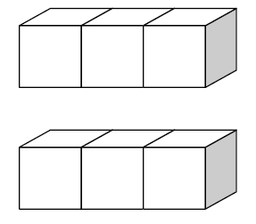
4. Quiz
Which is one way to tell how many blocks are shown below?
2 x 1 2 x 2 2 x 3
Notes:
MEAP Released Question
http://www.gobles.org/ElementarySchool/ReleasedMEAPItems/tabid/132/Default.aspx

Slide 32
Awesome !!!!
Nice job!
There are 2 groups of blocks
Each group has 3 blocks in
2 x 3=6

Slide 33
Twos hint
Did you know that when you multiply by two you just double the number.
For example: 2 x 6=?
You just double the 6 or you can add 6+6
This pictures shows you 2 groups of 6

Slide 34
5. Quiz
Faith had 15 blocks. She put the blocks in piles of 5 blocks each. How many piles of blocks did she have
3 5 10

Slide 35
Excellent Job
You are outstanding

Slide 36
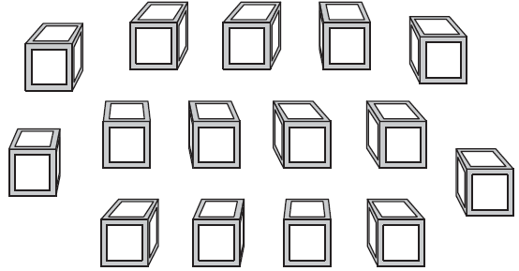
Block Problem
Here is a picture of the problem. Try to imagine making piles in your head, 5 blocks per group.
If you think you can solve it>press here
If you need more help>press here
Notes:
MEAP Released question
http://www.gobles.org/ElementarySchool/ReleasedMEAPItems/tabid/132/Default.aspx

Slide 37
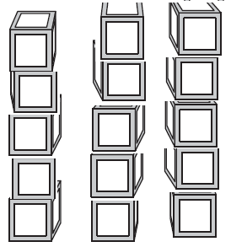
Block Problem
The piles are made for you
There are still 15 blocks, I put 5 blocks in each pile. How many piles are there?

Slide 38
WOW!
Nice work!
You did a really good job.
THE END!!!!

Slide 39
Resources
Michigan Mathematics 3rd grade GLCE
http://www.michigan.gov/documents/3rd_Math-Intro_Ltrweb_135031_7.pdf
MEAP Released Items
http://www.gobles.org/ElementarySchool/ReleasedMEAPItems/tabid/132/Default.aspx (I used the second option 3rd grade Math)
MEAP Released Items
http://www.linkstolearning.com/quizzes/meap/index0145.htm

